Slide 1

SOEE1475 Statistics and Data Analysis
Lecture 7: Directional statistics
Graeme T. Lloyd

Slide 2

Today
Complexities of circular data
Resultant
von Mises distribution

Slide 3
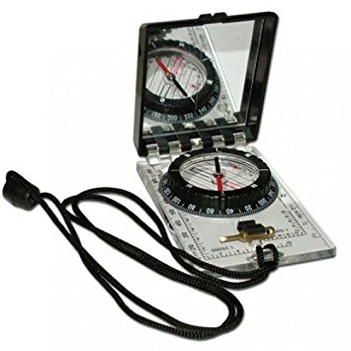
Circular measurements

Slide 4
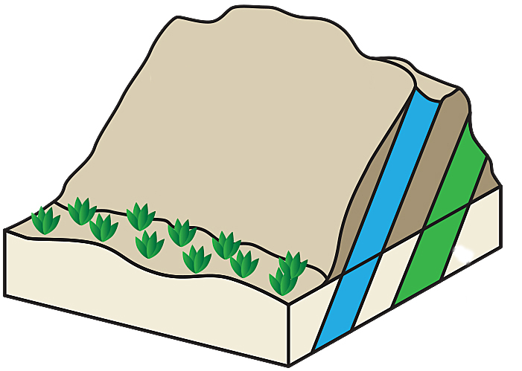
Circular measurements
Strike
Azimuth
Dip
Plunge

Slide 5
Circular measurements
Dip/plunge
Strike
Azimuth
Closed, 0-90
Modulo, 0-180
Modulo, 0-360
0
360/0
0
90
180

Slide 6
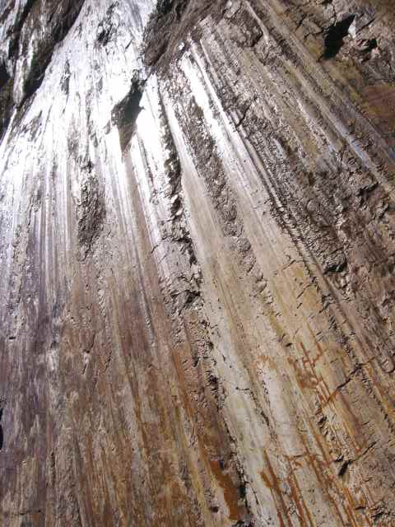
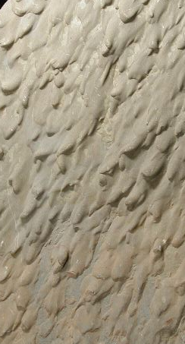
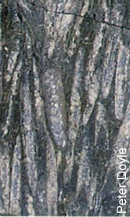
Directional measurements
Slickensides
Flute casts
Oriented fossils

Slide 7
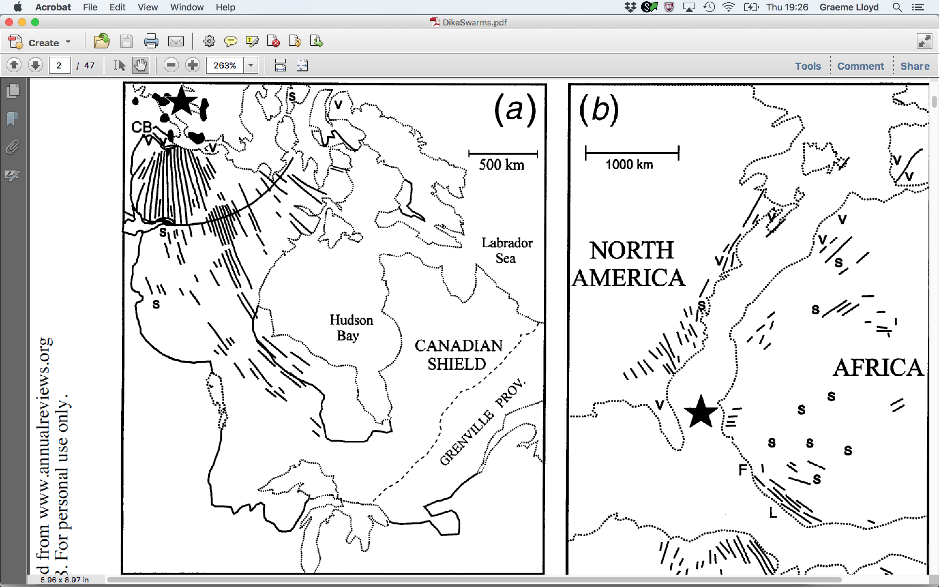
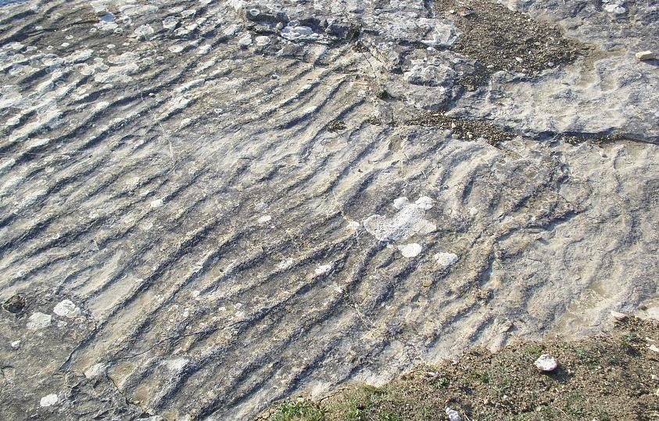
Orientation measurements
Ripple crests
Dike swarms

Slide 8
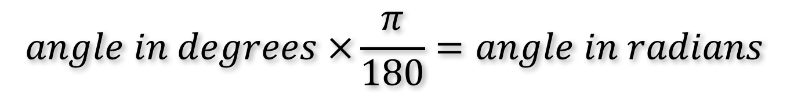
Degrees and radians
$$angle in degrees ×\frac{π}{180}=angle in radians$$
57.2958 degrees
1 radian

Slide 9

R
library(circular)

Slide 10
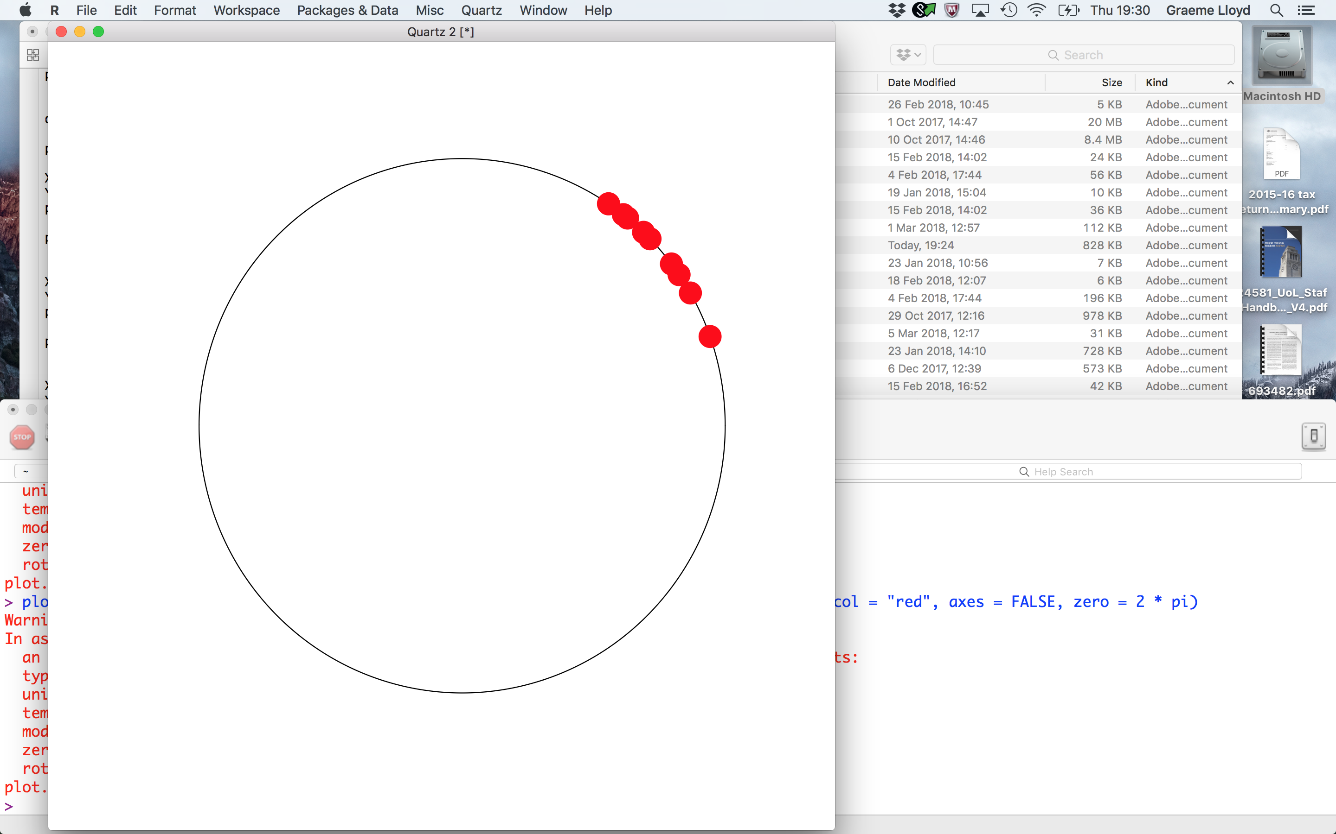
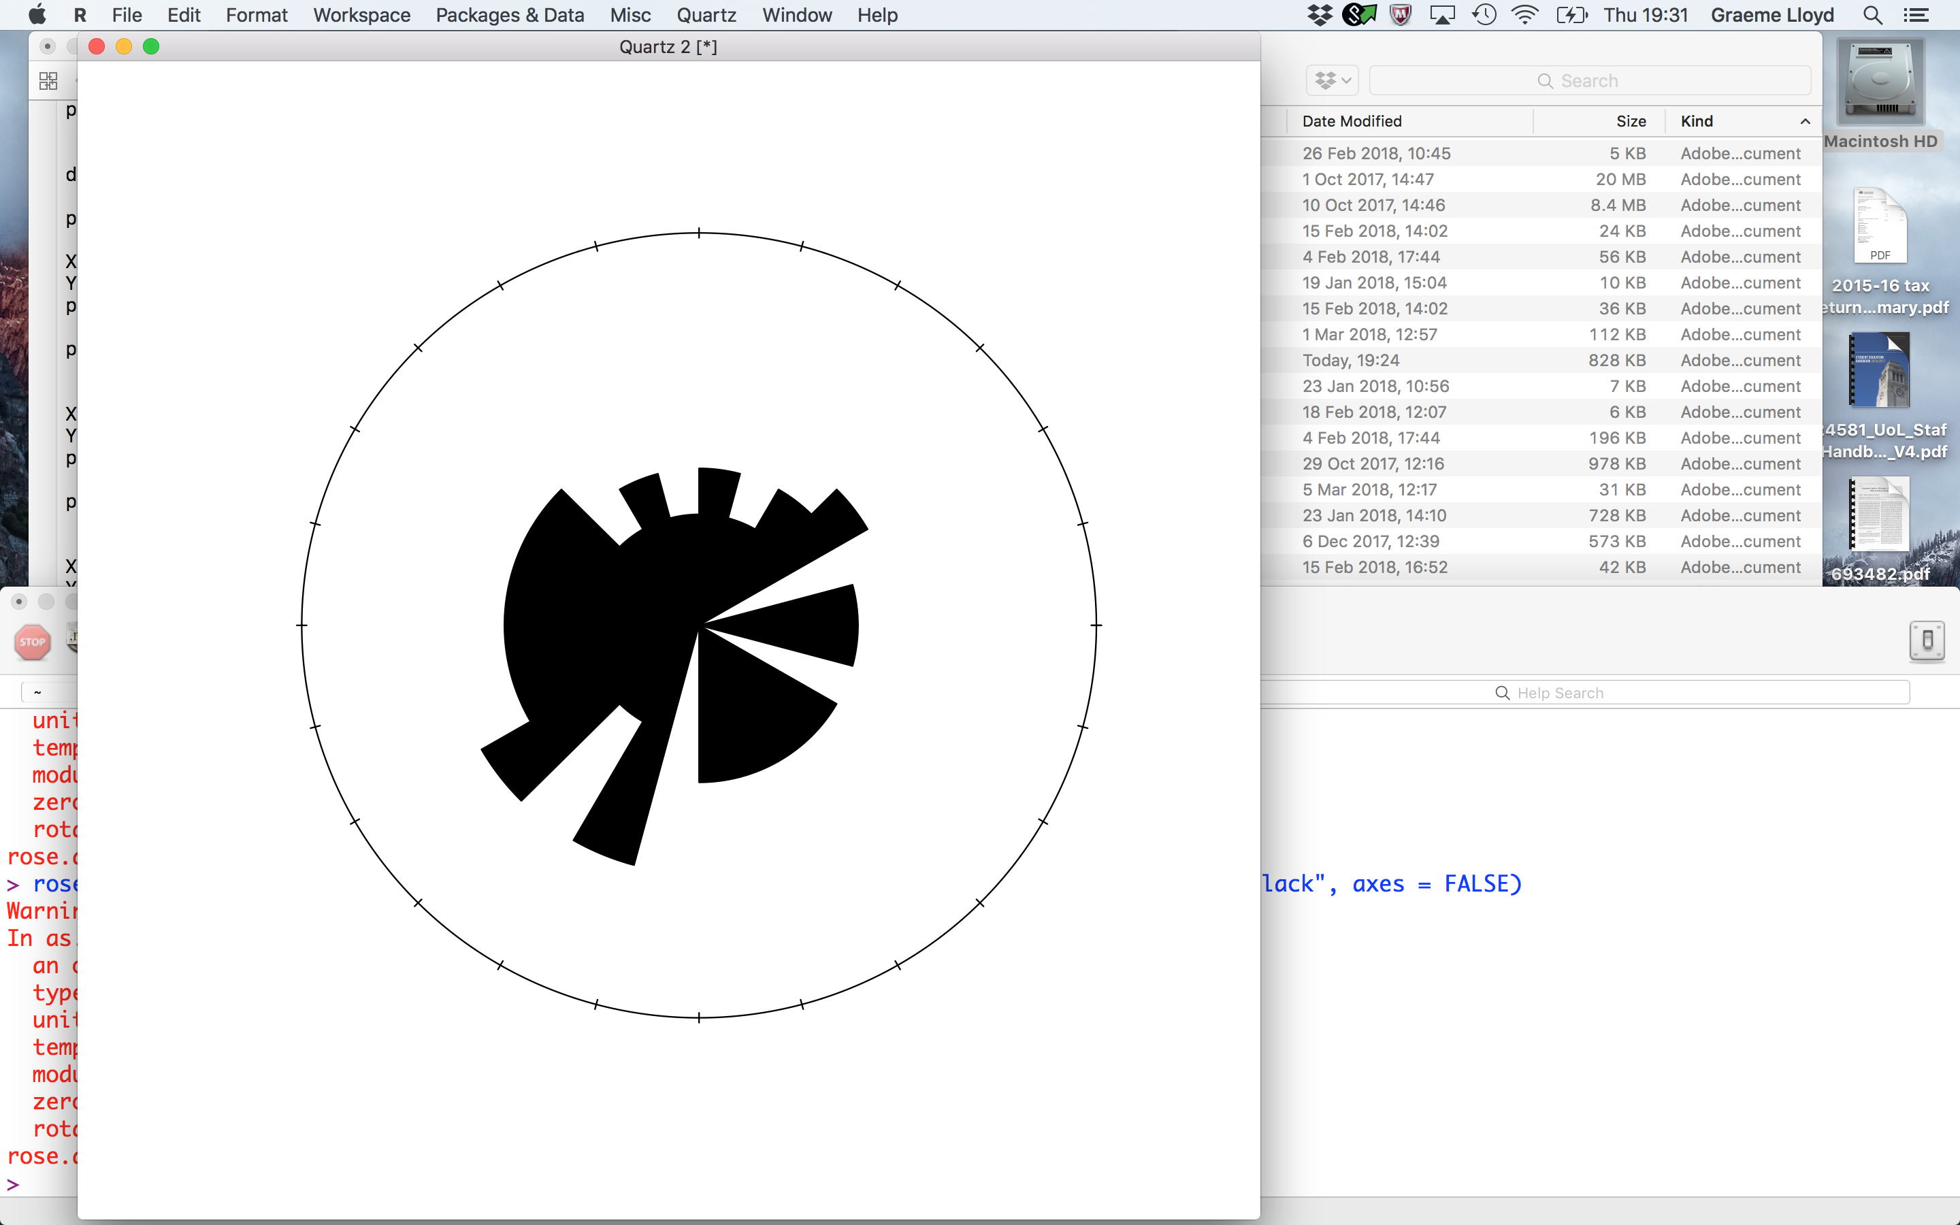
Visualisations
Circle plot
Rose diagram

Slide 11
Resultant
Unit vectors
Arrange as path
Resultant
Short
Long

Slide 12
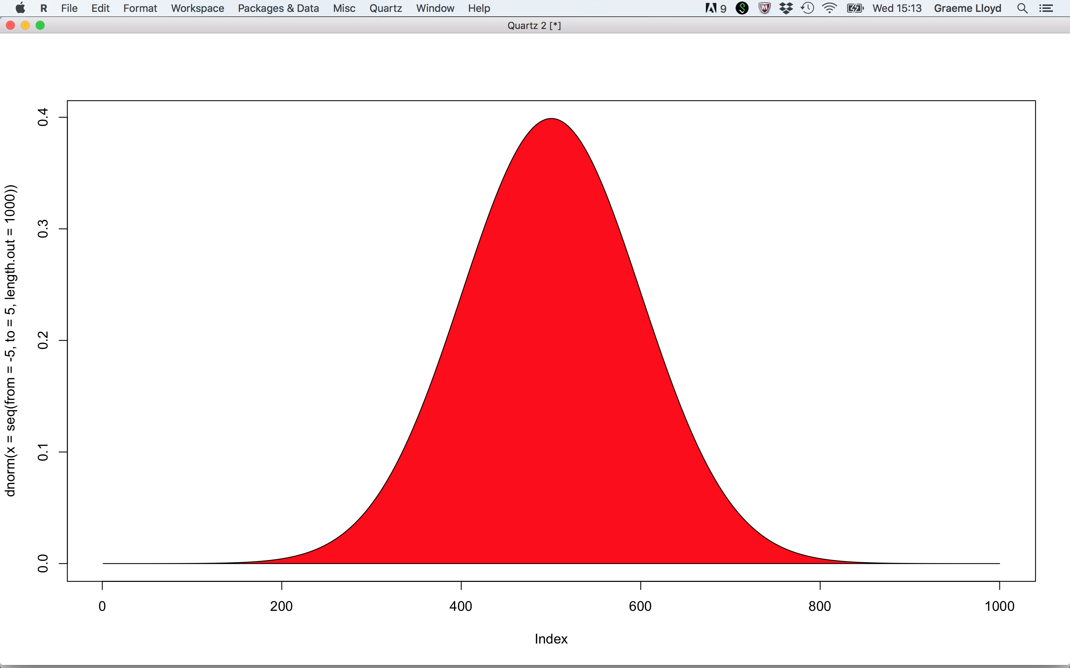
Resultant
Resultant
Dispersion
Mean
Short
Long

Slide 13
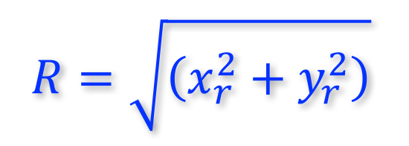
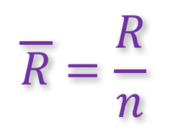
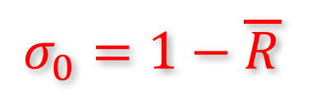
Resultant
Resultant length
$$R=\sqrt{\left(x_{r}^{2}+y_{r}^{2}\right)}$$
Inverse of dispersion; scales with n
Mean resultant length
$$\overline{R}=\frac{R}{n}$$
Rescaled, allowing comparison across samples; 0-1 range
Circular variance
$$σ_{0}=1−\overline{R}$$
Varies from 0 (low) to 1 (high)

Slide 14
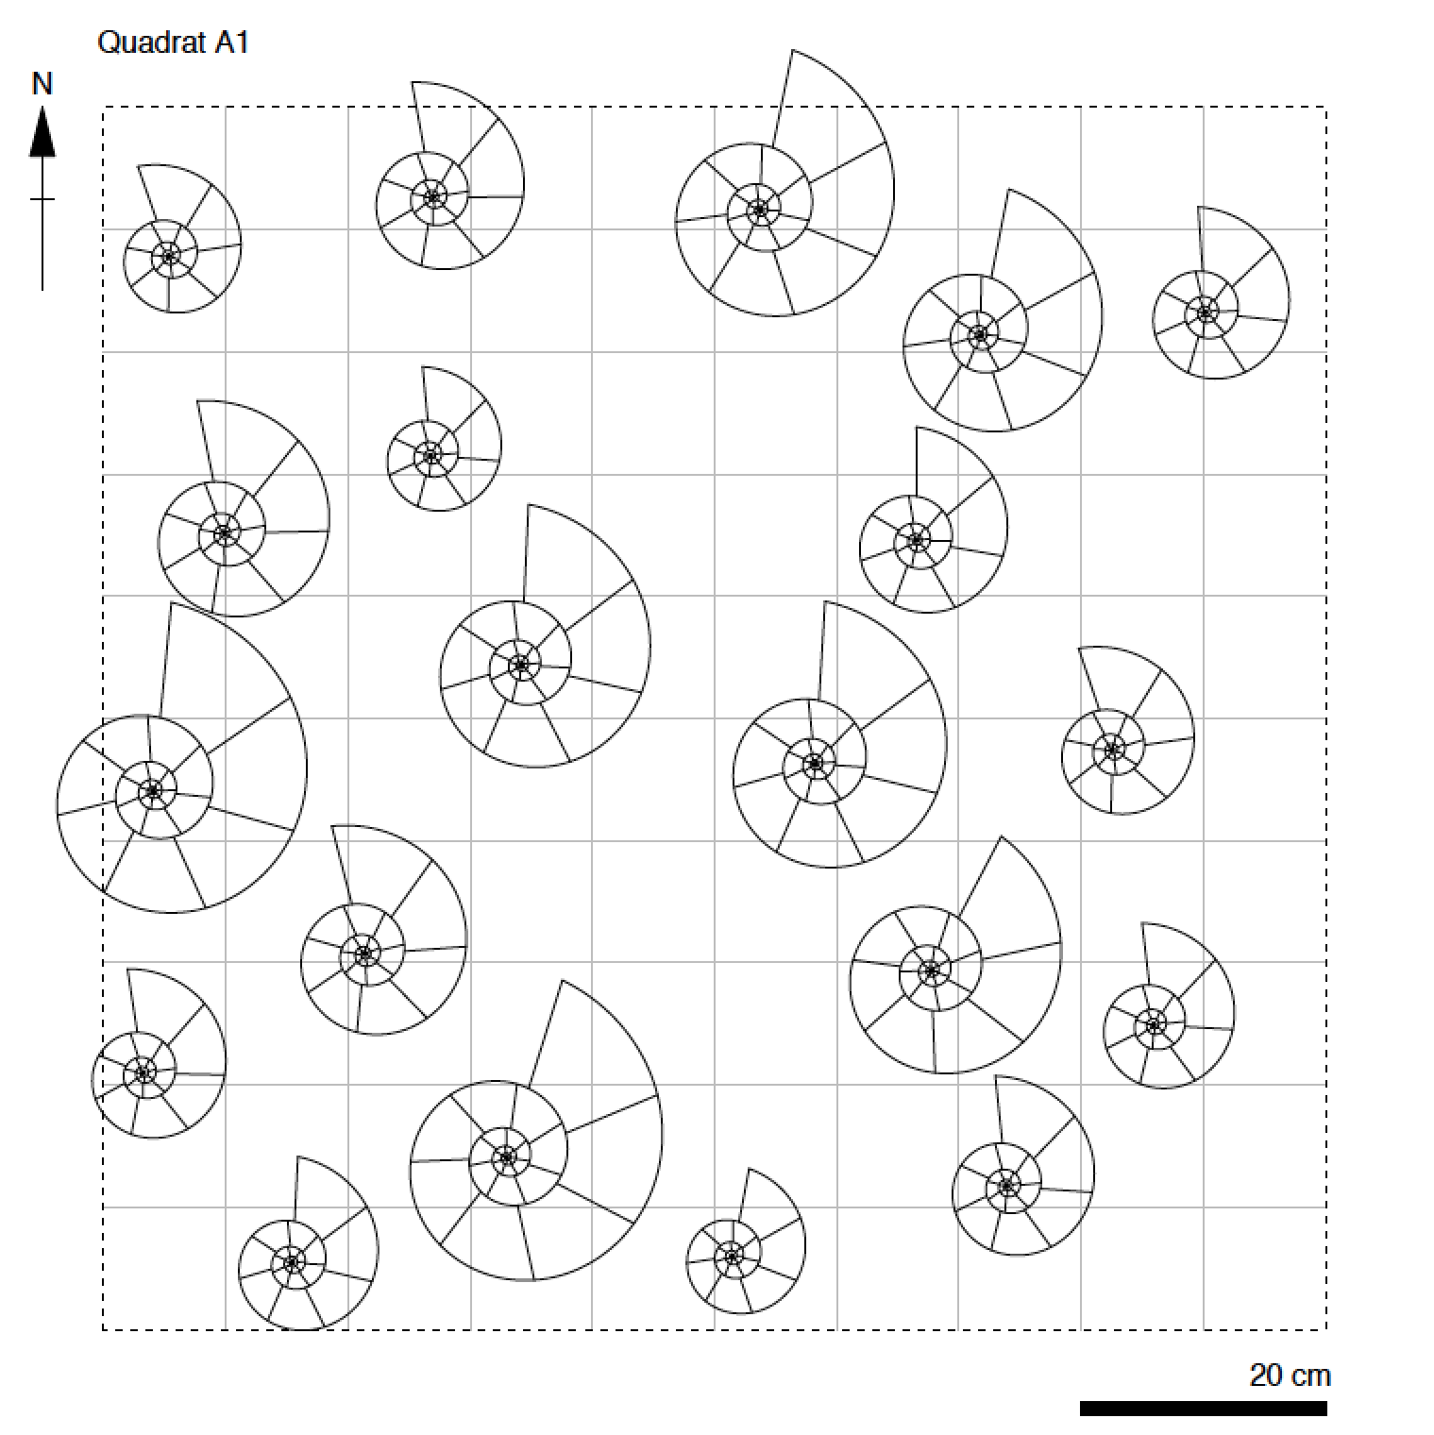
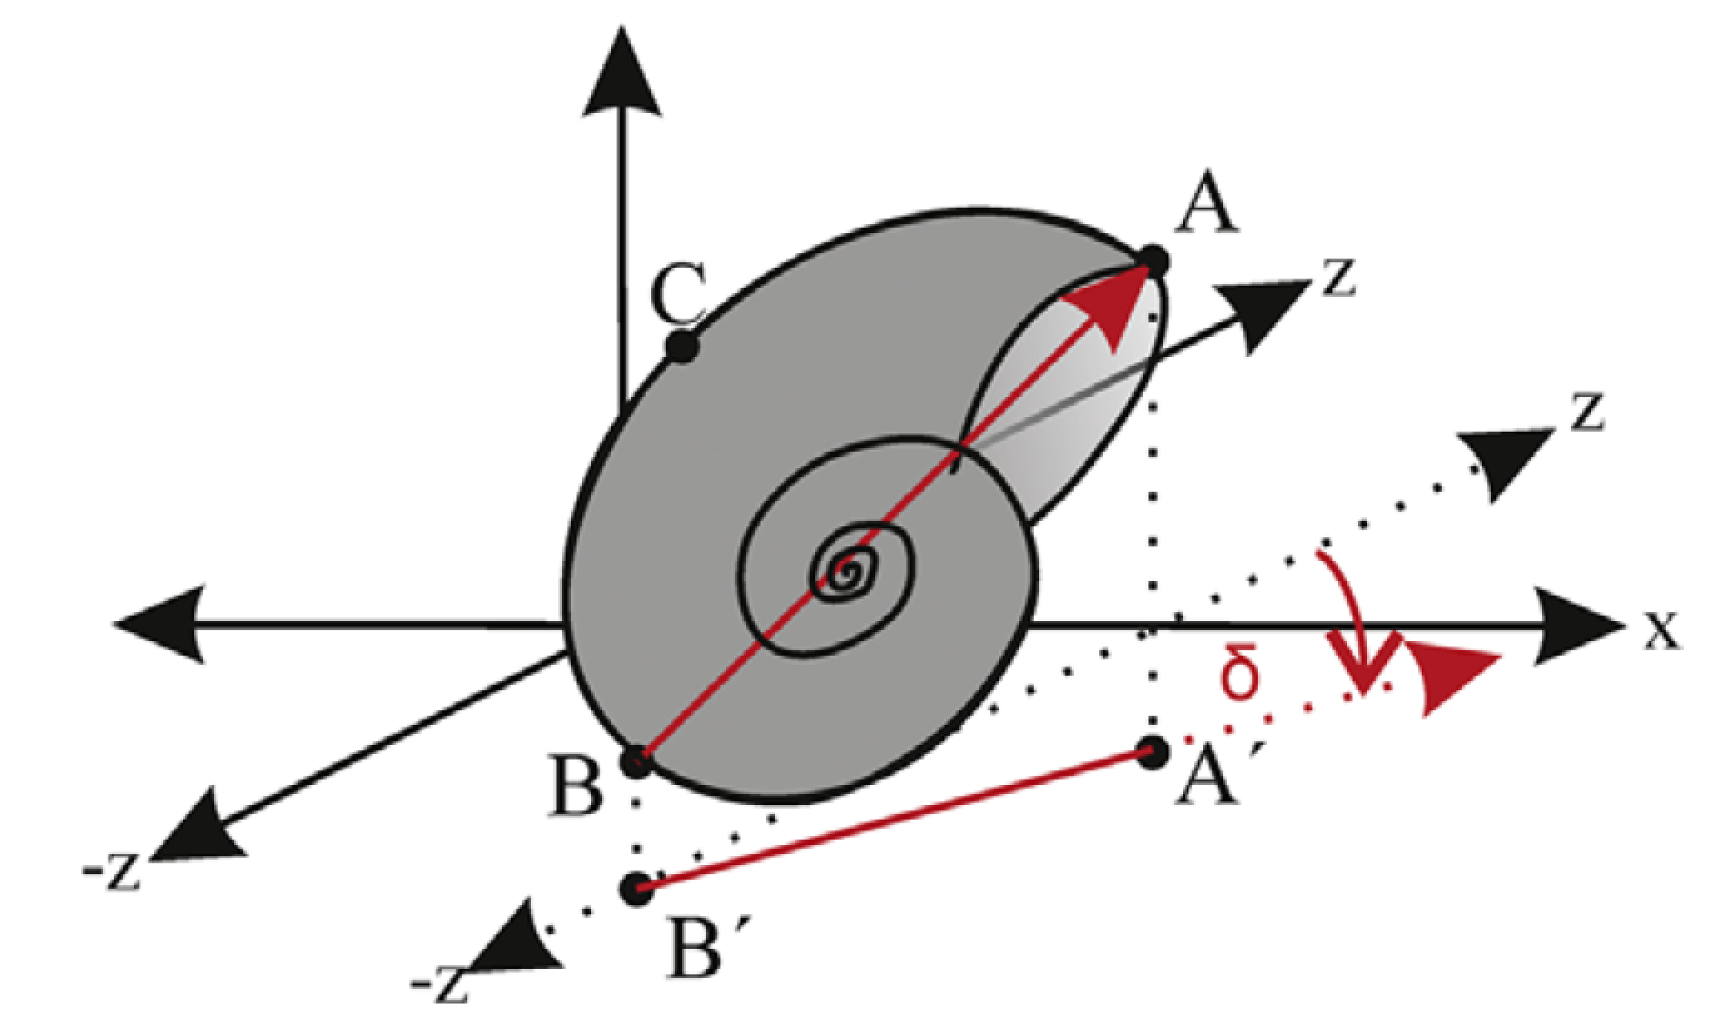
Exercise
Lukeneder et al 2014 Computers & Geosciences

Slide 15
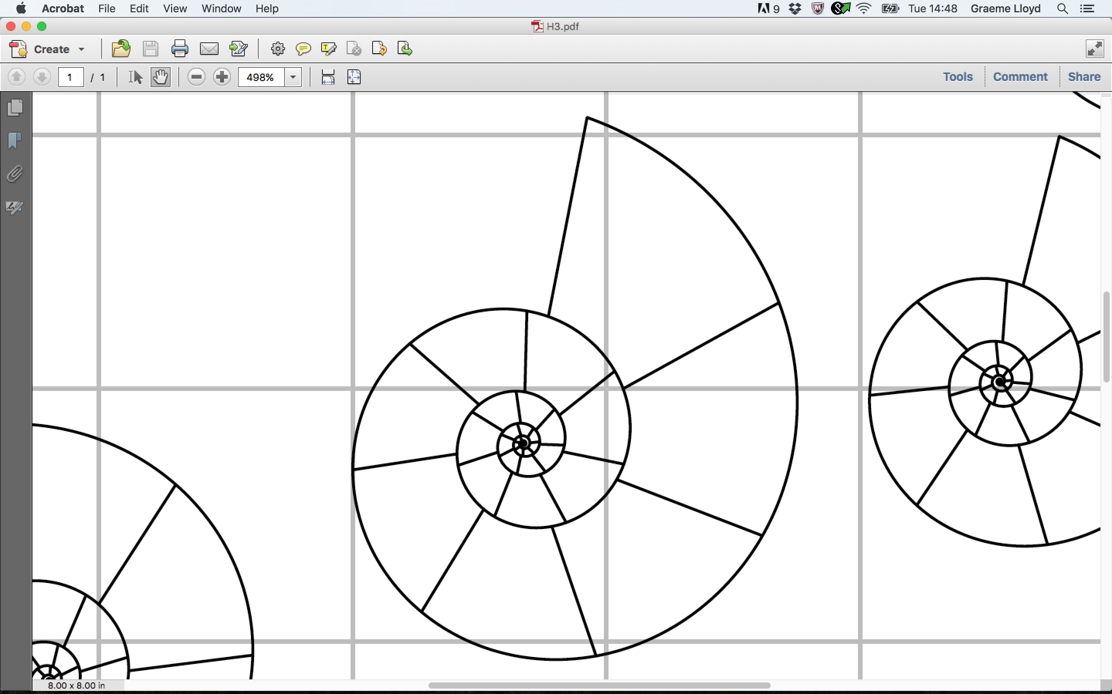
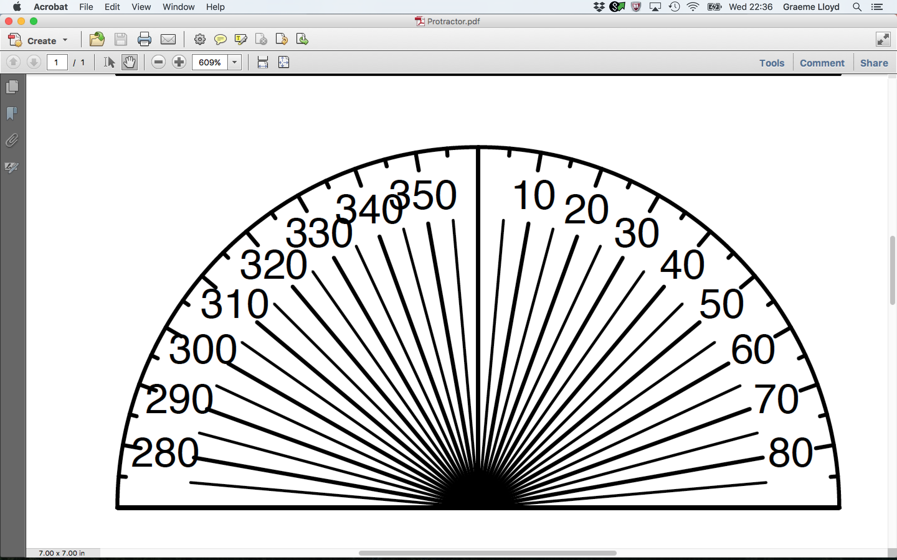
Exercise

Slide 16
Exercise
Measure ammonites 1 and 2 only
Units of protractor are bearings in degrees
Bin your data (for a histogram)
A
B
C
D
E
F
G
H
I
J
310
320
330
340
350
360
10
20
30
40
50
J10: 1 = 29, 2 = 354

Slide 17
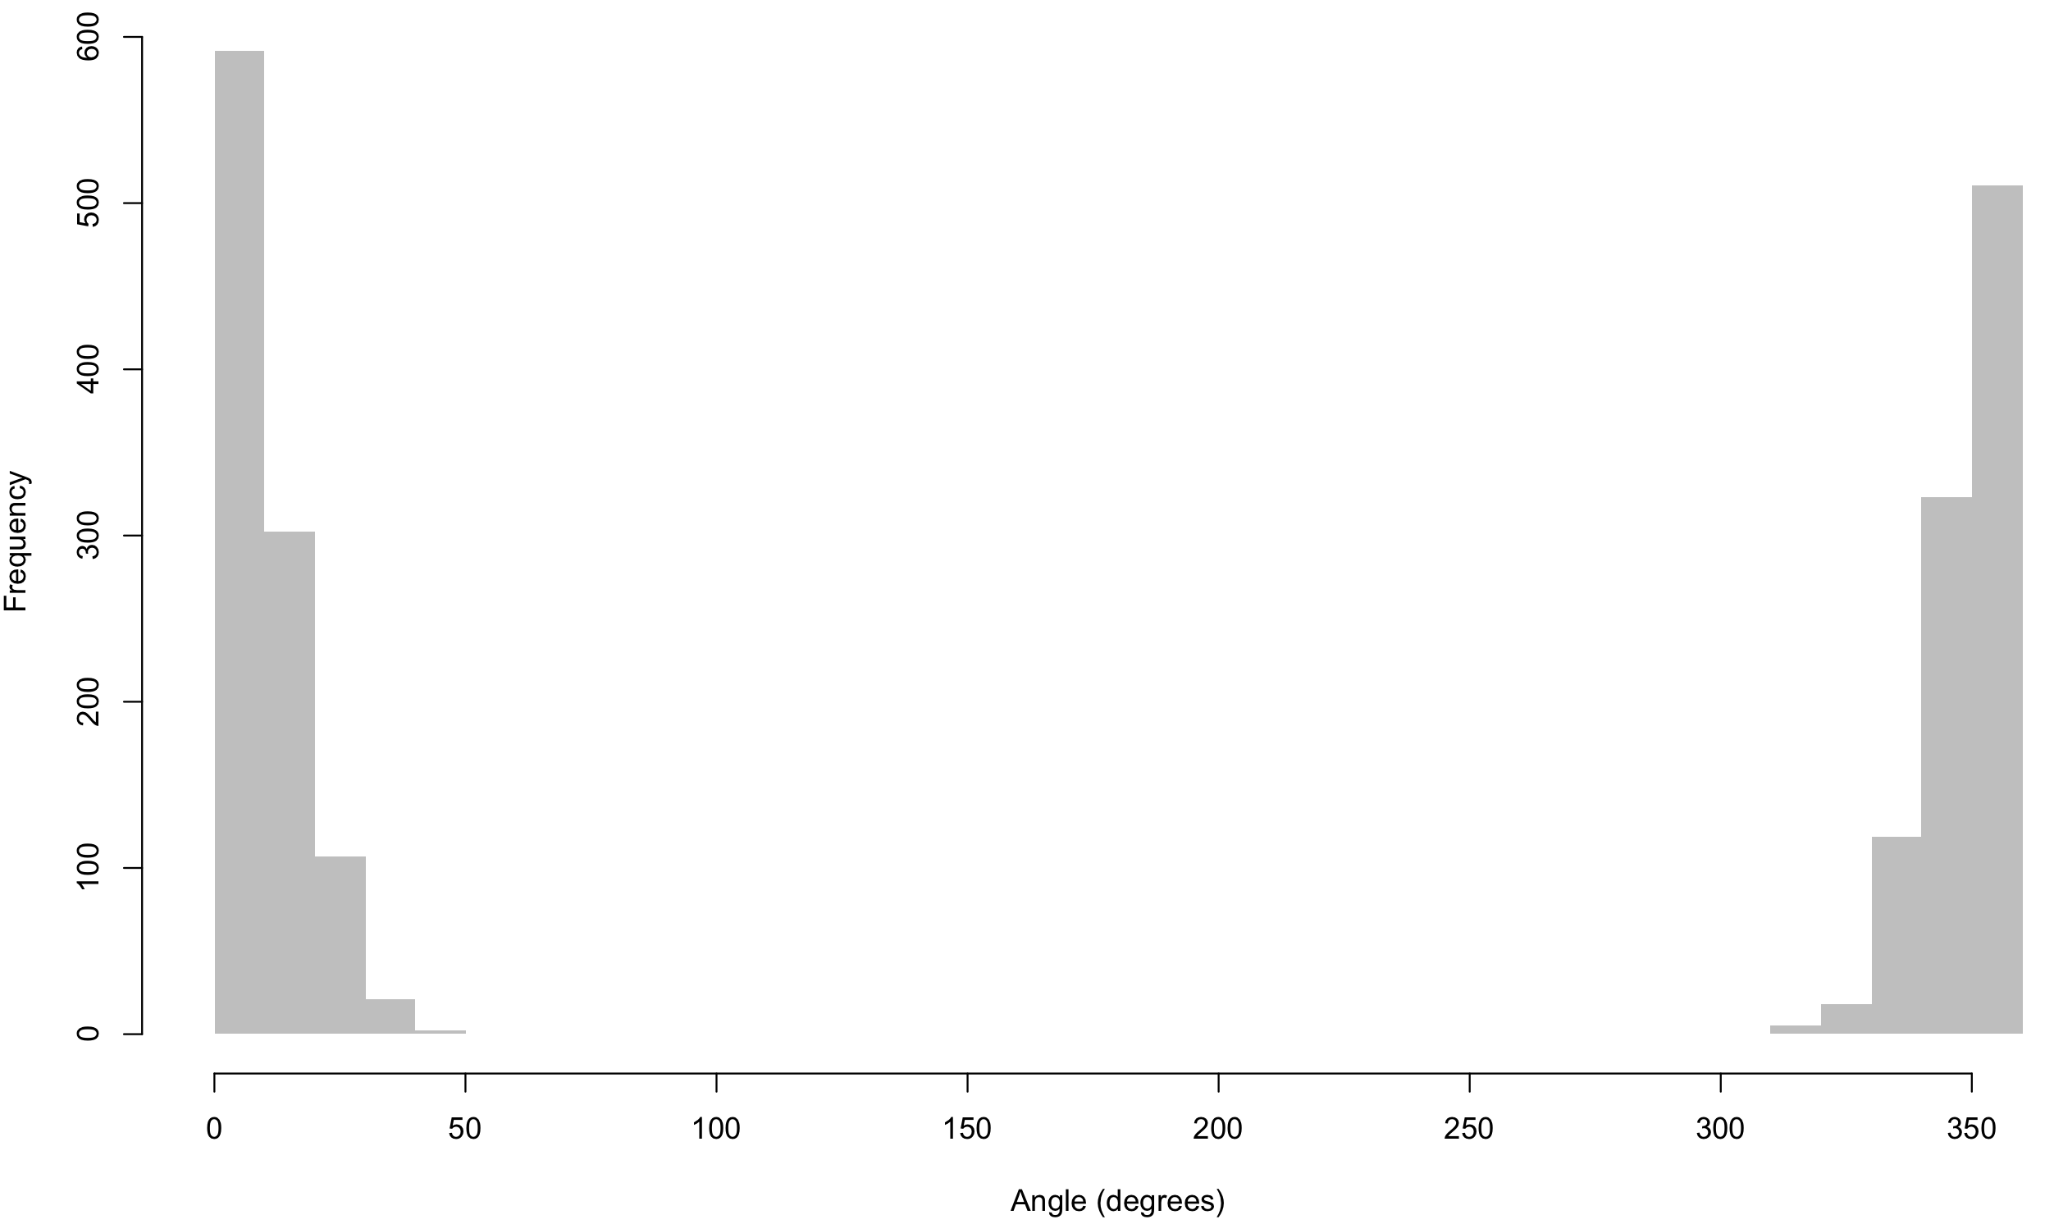
Exercise

Slide 18
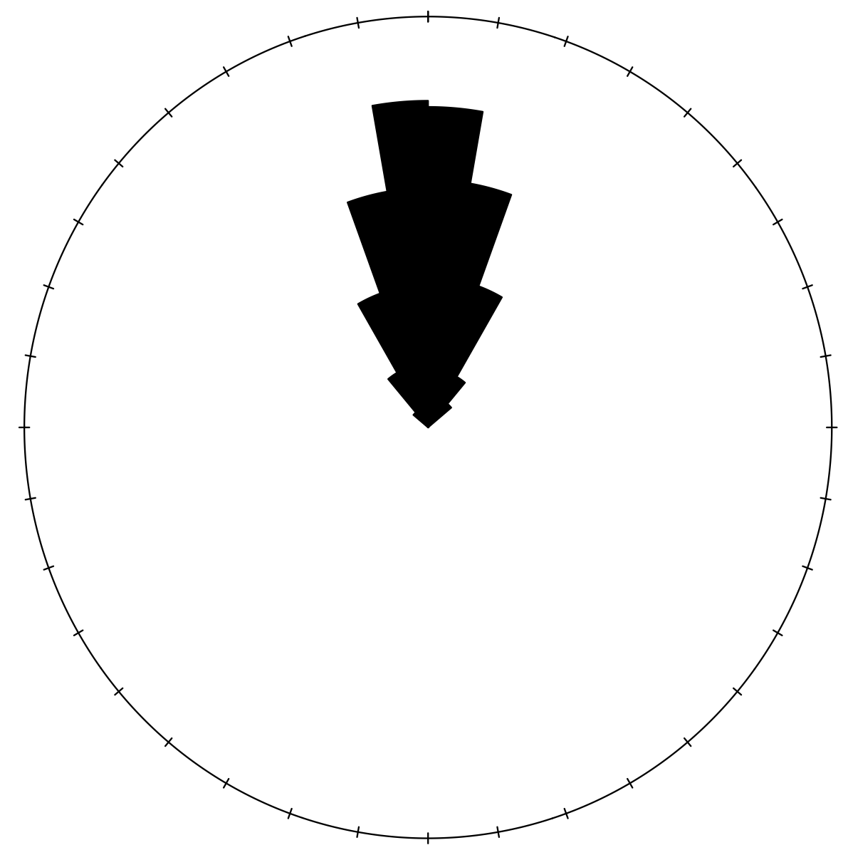
Exercise

Slide 19
Exercise
Measure ammonites 3-5
Calculate mean for all five bearings
J10: 1 = 29
2 = 354
3 = 346
4 = 4
5 = 9

Slide 20
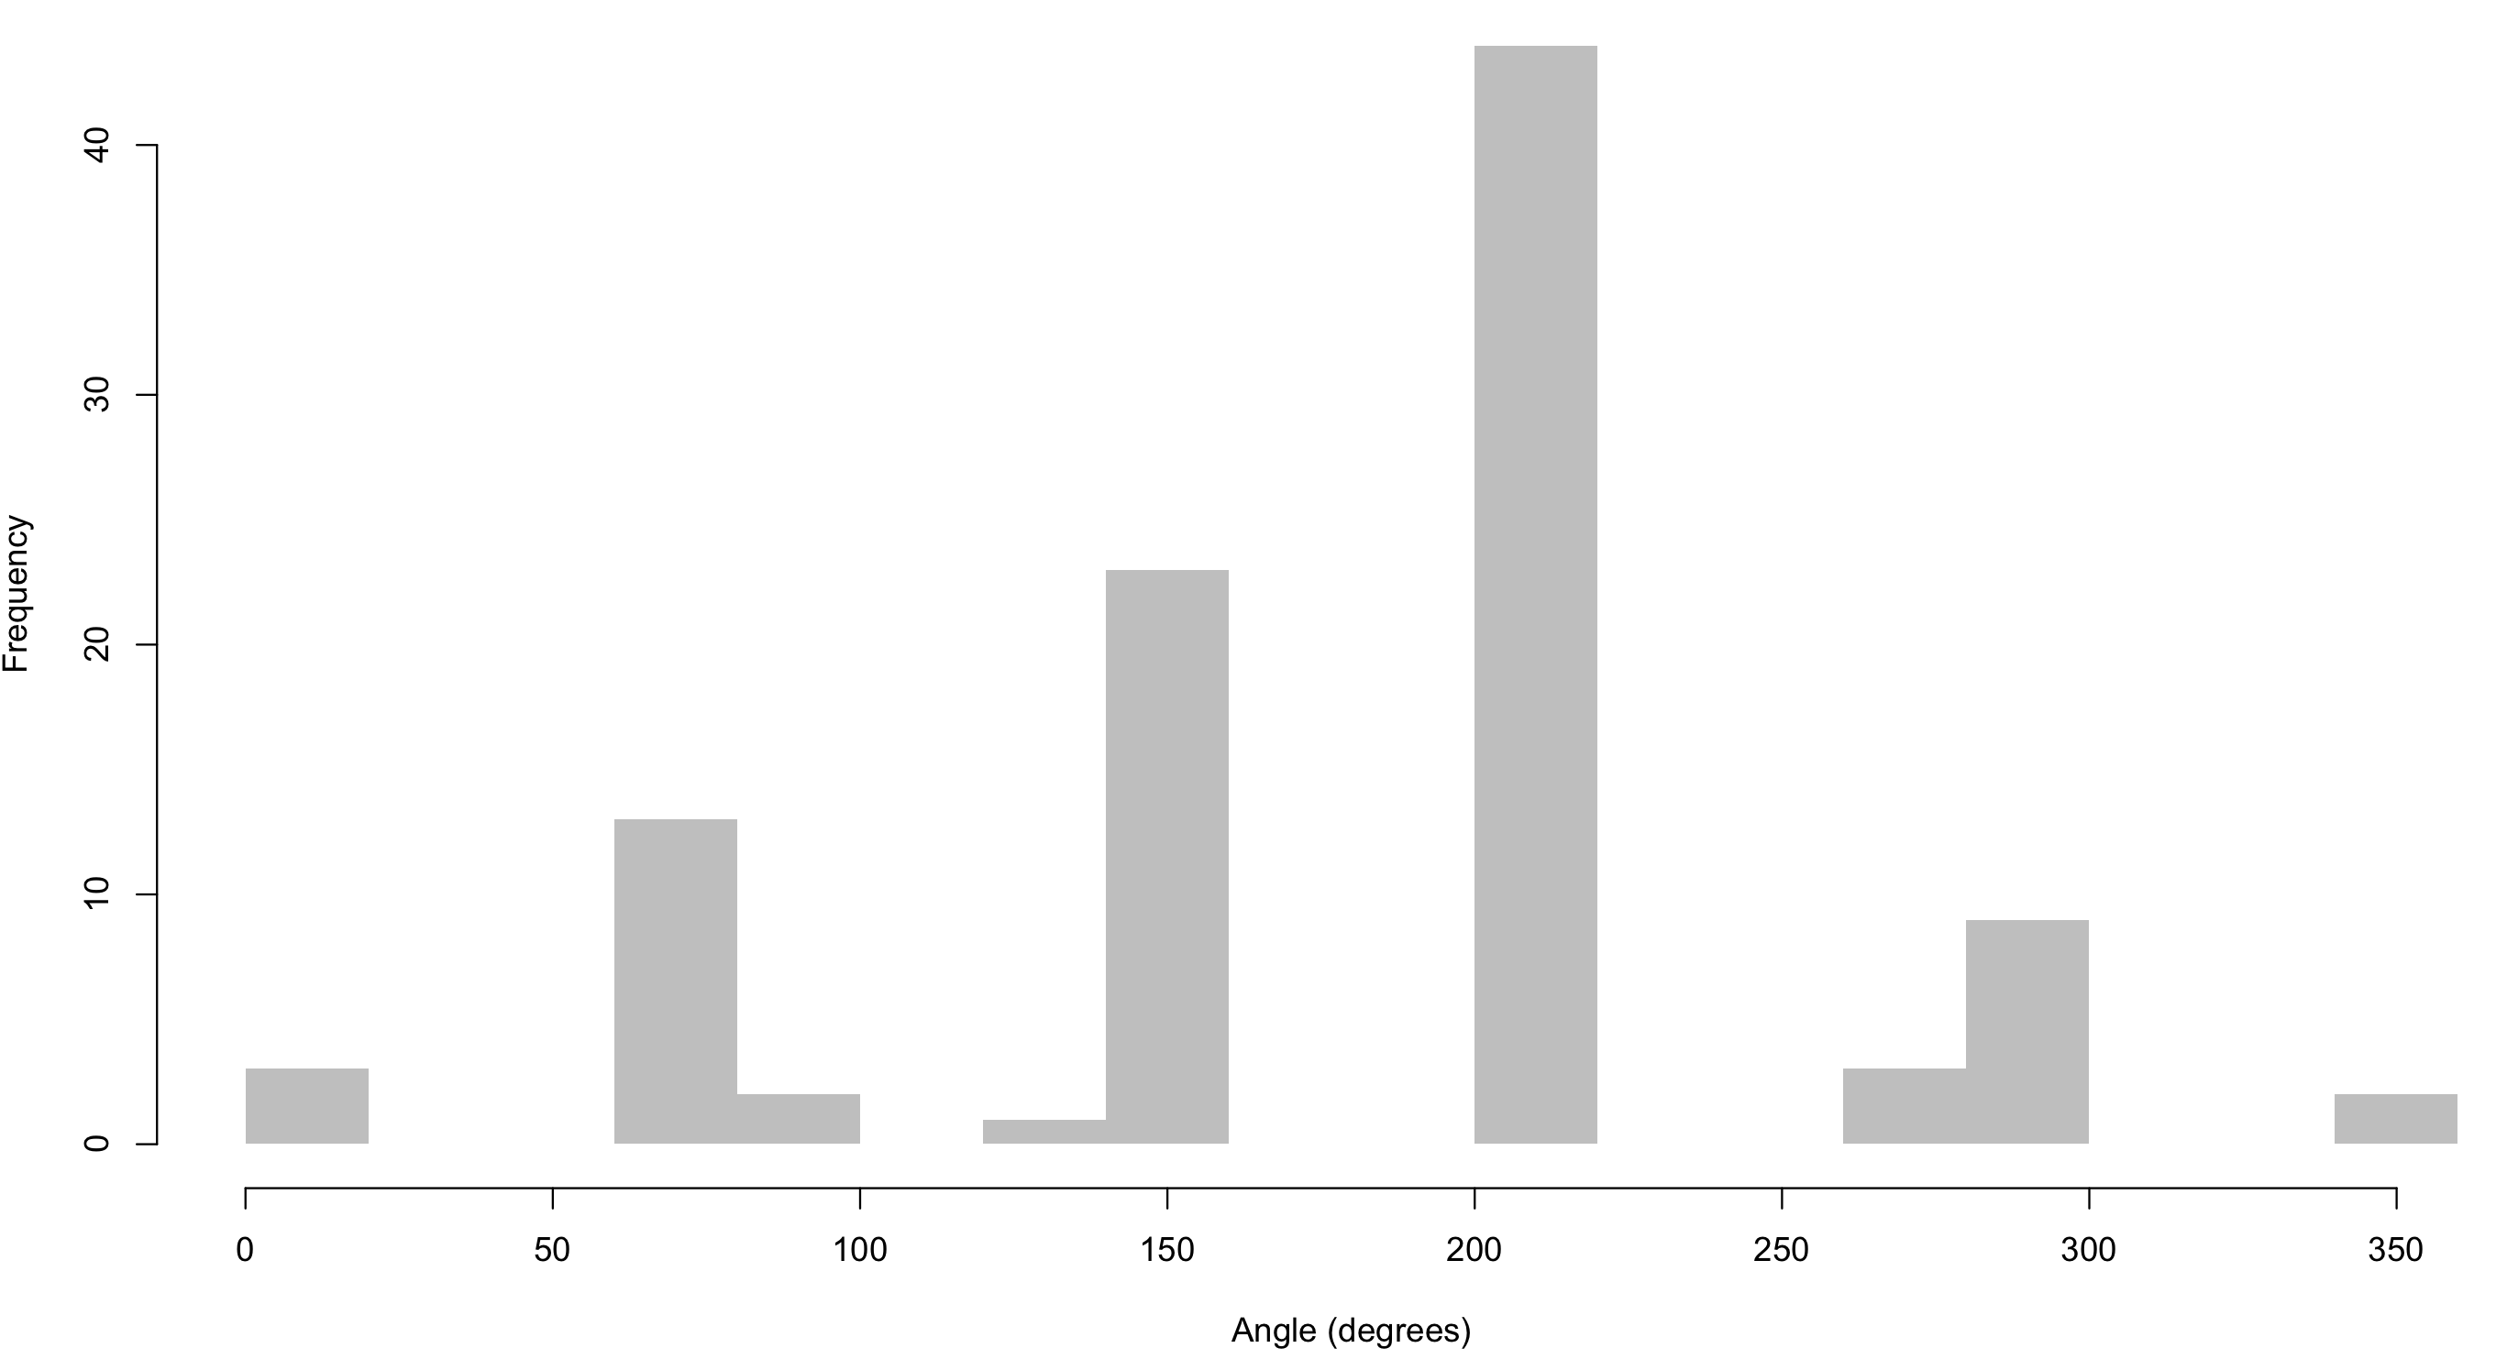
Mean bearing of first five ammonites

Slide 21
von Mises distribution
-∞
+∞

Slide 22
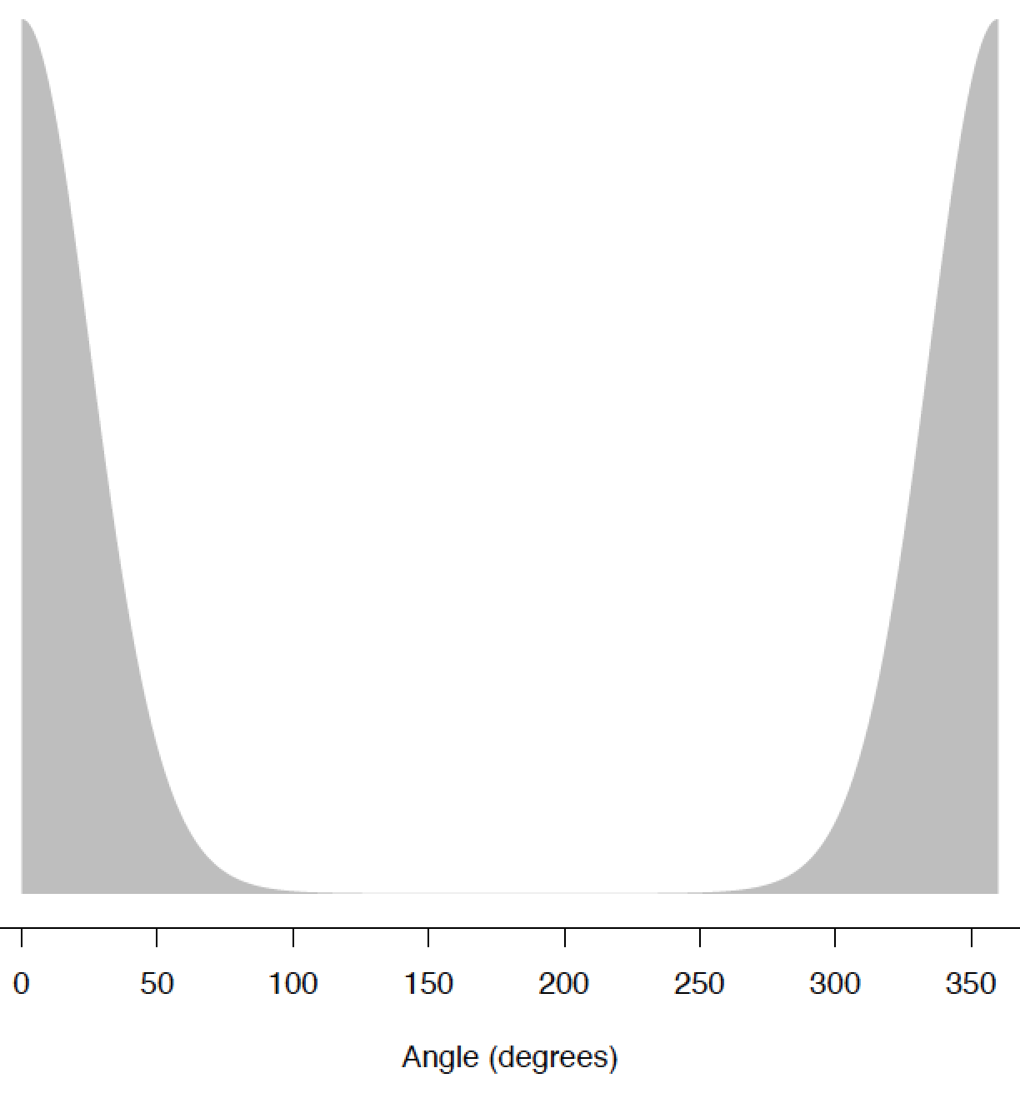
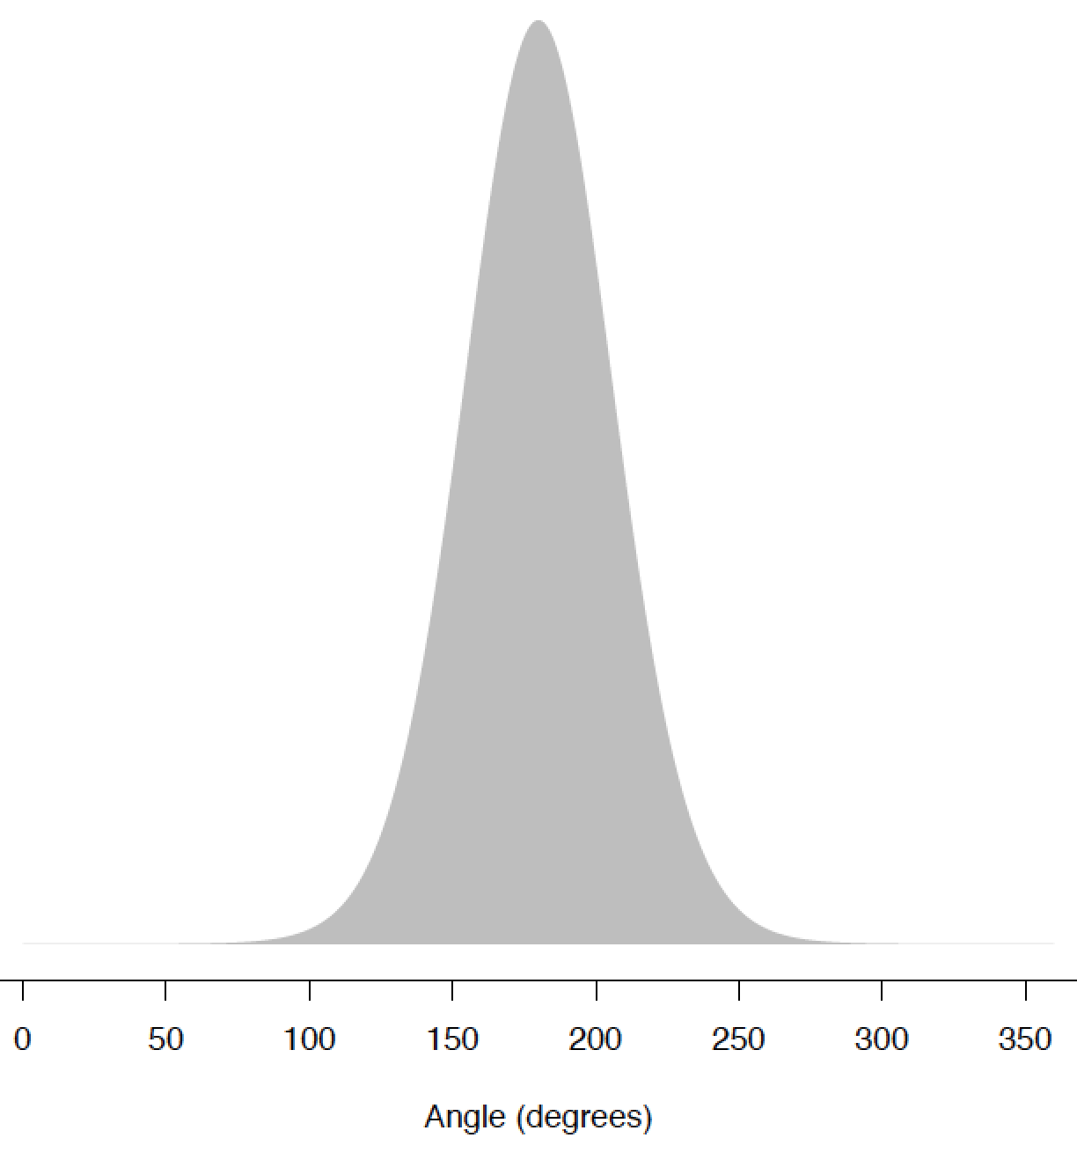
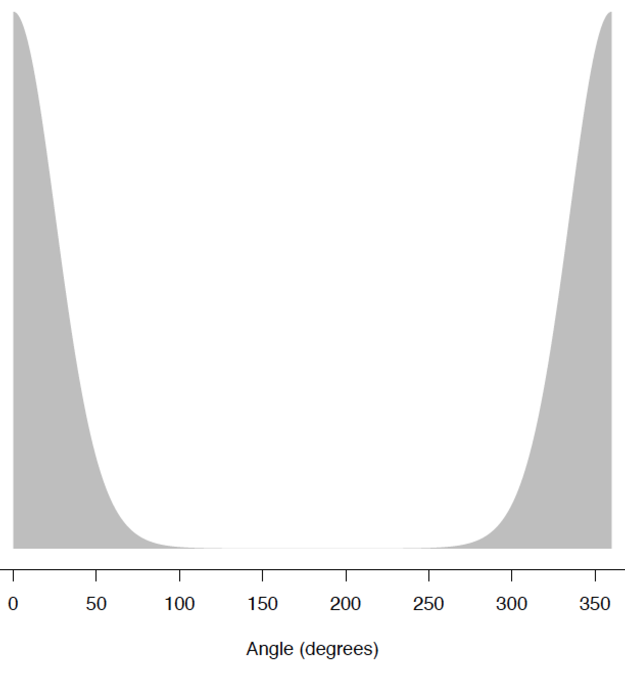
von Mises distribution
μ = 0
μ = 180
μ = 360
0
360
0
360
0
360

Slide 23
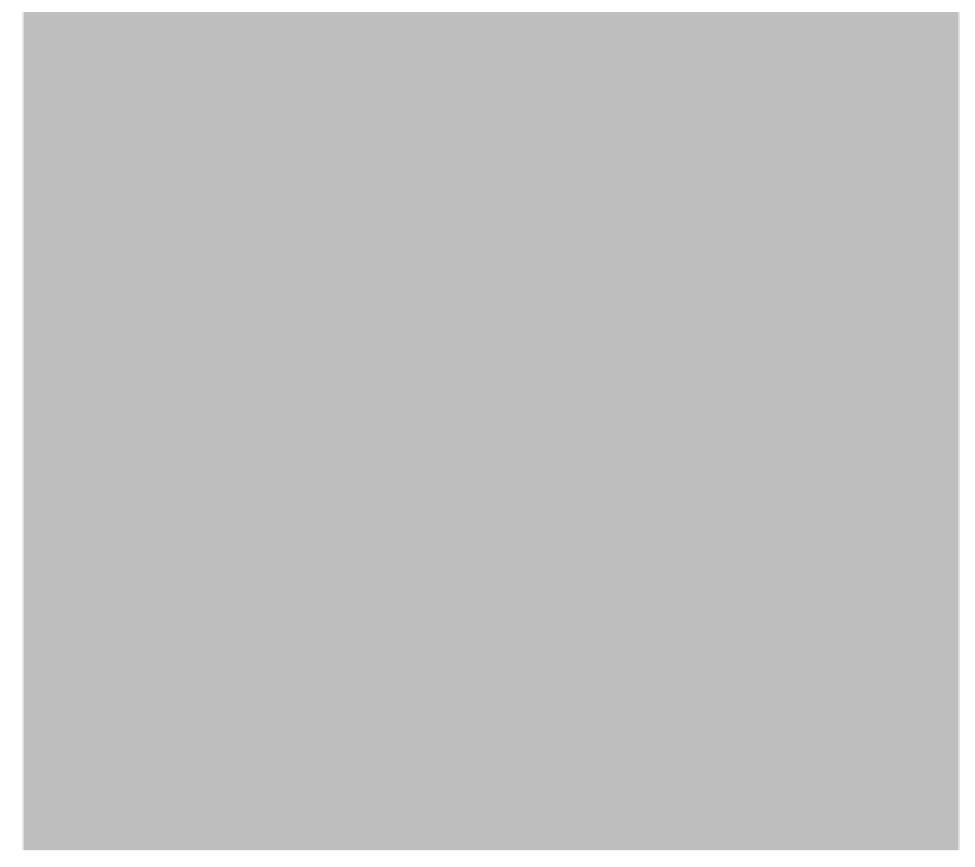
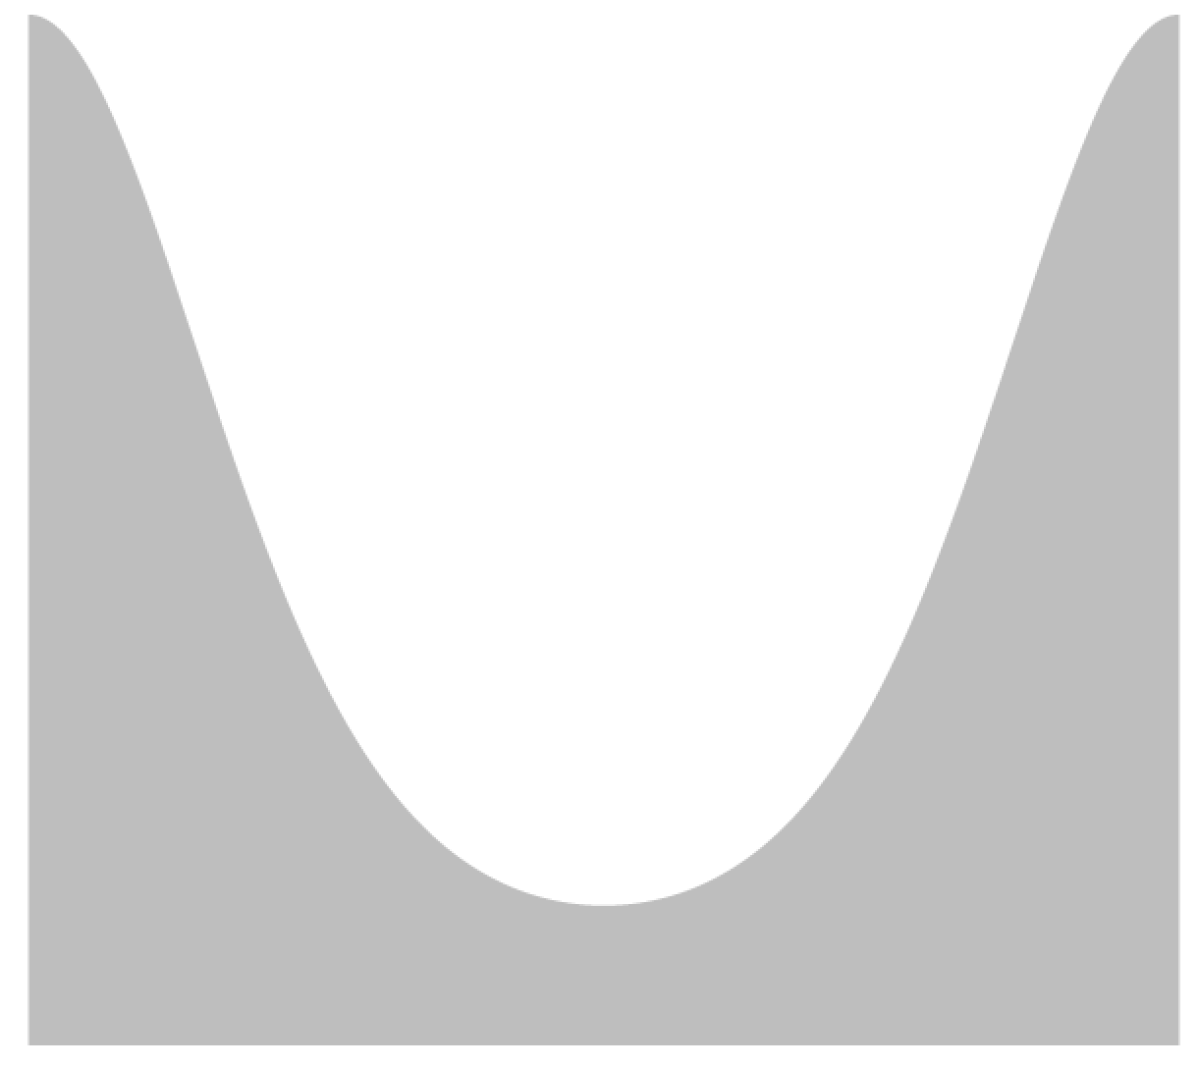

von Mises distribution
𝚱 = 0
𝚱 = 1
𝚱 = 5
0
360
0
360
0
360

Slide 24

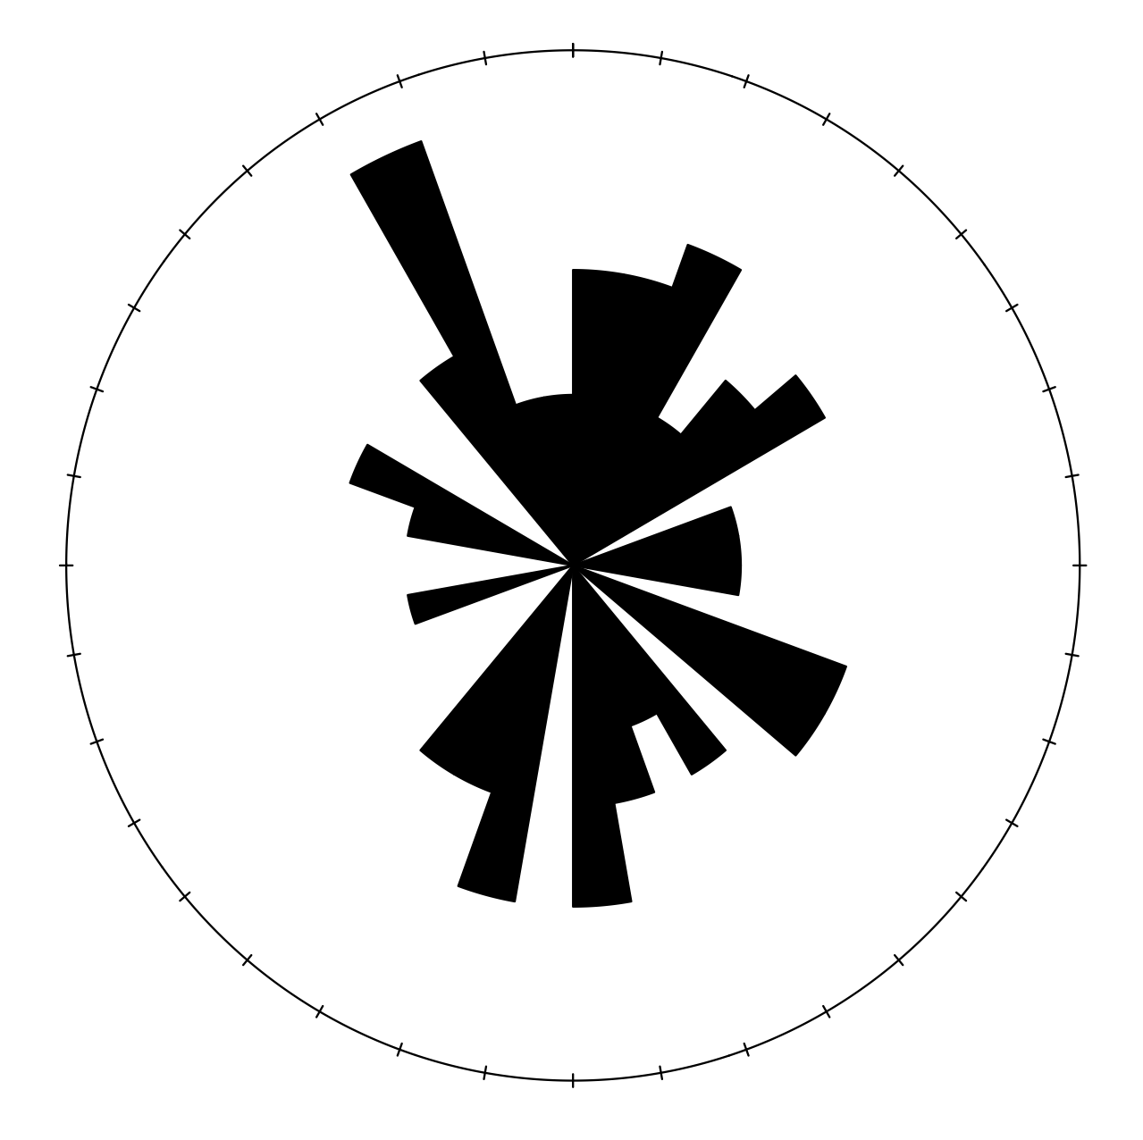
Statistical tests with directional data

Slide 25
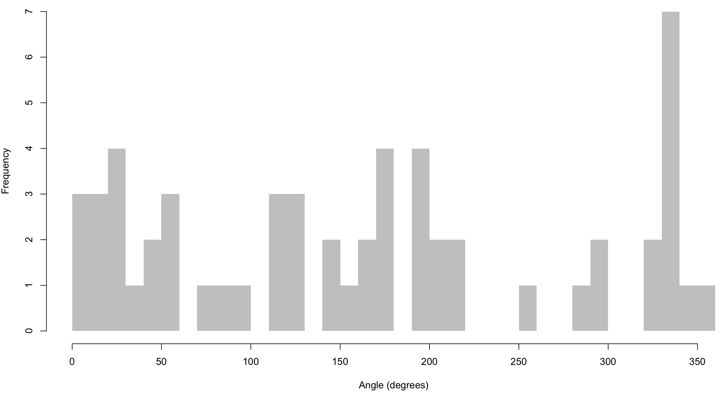
Statistical tests with directional data
μ = 166.6
-σ
+σ

Slide 26
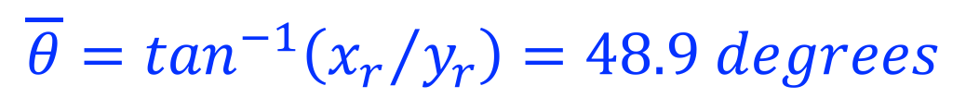
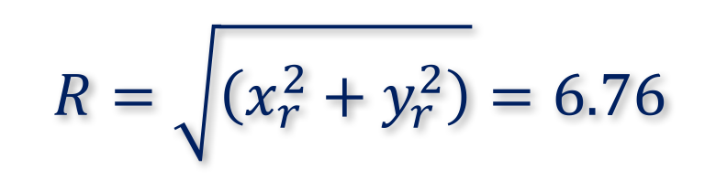
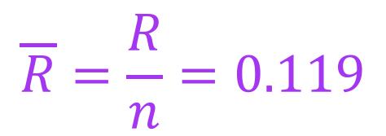
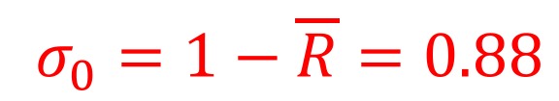
Statistical tests with directional data
Resultant angle
$$\overline{θ}=\tan^{−1}\left({x_{r}}/{y_{r}}\right)=48.9 degrees$$
Resultant length
$$R=\sqrt{\left(x_{r}^{2}+y_{r}^{2}\right)}=6.76$$
Mean resultant length
$$\overline{R}=\frac{R}{n}=0.119$$
Circular variance
$$σ_{0}=1−\overline{R}=0.88$$

Slide 27
Statistical tests with directional data
Univariate mean
Circular mean

Slide 28
Statistical tests with directional data
Rayleigh test
rayleigh.test(SkyeData)
P-value: 0.5501
Test for uniform distribution
Null hypothesis
Data are uniformly distributed
Alternative hypothesis
Data are non-uniform

Slide 29
Statistical tests with directional data
Cannot reject null at typical alphas (<0.5)

Slide 30
Statistical tests with directional data
von Mises distribution
Effectively circular normal
Kappa value
Estimation is effectively a separate test for uniform
𝚱 = 0.24175
Low value, indicating well dispersed data

Slide 31
Statistical tests with directional data
Chi-squared test
Can apply here to test for uniform; 20 degree bins
Chi-squared = 35.52
Degrees of freedom = 18 – 1 = 17
Alpha = 0.05
Critical value 8.67, therefore reject null; data are non-uniform

Slide 32
Statistical tests with directional data
Issue may be polymodality

Slide 33
Other tests
One sample t-test equivalent (alpha = 0.05)

Slide 34
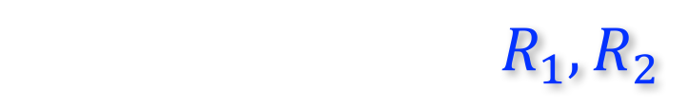



Other tests
Two-sample t-test equivalent
$$R_{1},R_{2}$$
Compares resultants of two samples
R₁ and R₂ are resultants of each sample
$$R_{T}$$
R_{T} is resultant from combined data
Close means indicate approximately equal values
$$R_{1}+R_{2}≈R_{T}$$
Distant means indicate smaller combined resultant
$$R_{1}+R_{2}≫R_{T}$$

Slide 35
Other tests
R₁
R₂
R_{T}
Modified F-statistic allows null hypothesis statistical testing

Slide 36
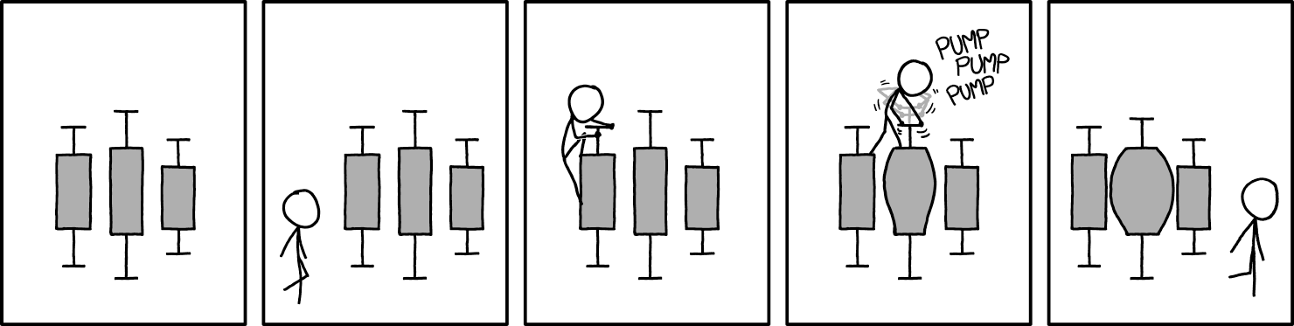
Boom goes the dynamite
Source: xkcd

